Slide 1

Unit-4
Phishing and Identity Theft

Slide 2
Unit-4
Phishing and Identity Theft
Presented By:
C Sharmila Suttur
ECE, RIT

Slide 3

Phishing
A type of e-mail scam that steals your identity.
An e-mail fraud technique in which the culprit sends out e-mails looking legitimate in an effort to accumulate personal and financial information from recipients (messages likely come from well-known and trustworthy sites, viz., PayPal, eBay, MSN, Yahoo, BestBuy, and America Online).
Phishers use a different social engineering and e-mail spoofings to try to trick their victims.
The act of sending an e-mail to a user and falsely claiming to be an established legitimate organization to scam the user into giving up private information to be used for identity theft.
The e-mail steers the user to visit a Web site where they are asked to update their personal information, viz., their passwords and information about their credit cards, bank account numbers, etc.

Slide 4
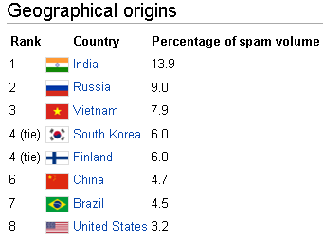
(Courtesy : 2011 Cisco System report)

Slide 5
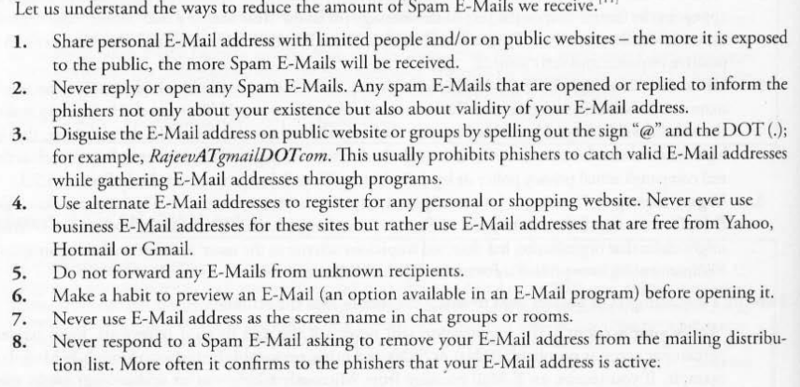

Slide 6
Spam E-Mails
Also known as “junk E-Mails”
Identical messages are sent to numerous recipients
Popular medium for phishers to scam users to enter personal information on fake websites
A person who creates electronic spam is called a spammer
Types
Unsolicited bulk E-Mail (UBE)
Unsolicited commercial E-Mail (UCE)

Slide 7
Tactics used by a phisher
Names of legitimate organizations
“From” a real employee
URLs that “look right”
Urgent messages
Phrases used to entice the user
“Verify your account”
“You have won the lottery”
“If you don’t respond within 48 hours, your account will be closed”
www.breakthechain.org
www.hoaxbusters.org

Slide 8
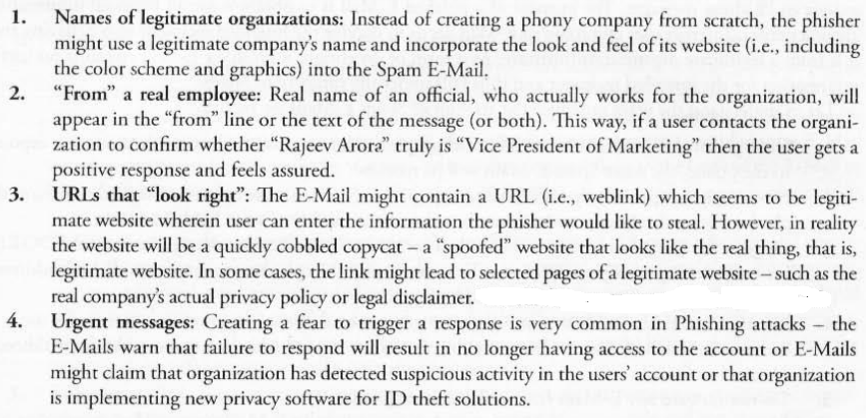
Tactics used by a phisher

Slide 9
Hoax E-Mails
Deliberate attempt to deceive or trick a user into believing or accepting that something is real.
Hoax E-Mails may or may not be Spam E-Mails.
Methods of Phishing
Dragnet (use of spammed E-Mails)
2. Rod-and-reel (identifying specific prospective victims in advance and convey false information to them to prompt their disclosure of personal and financial data)
3. Lobsterpot (focuses upon use of spoofed websites)
4. Gillnet (relies far less on social engineering techniques and phishers introduce Malicious Code into E-Mails and websites)

Slide 10

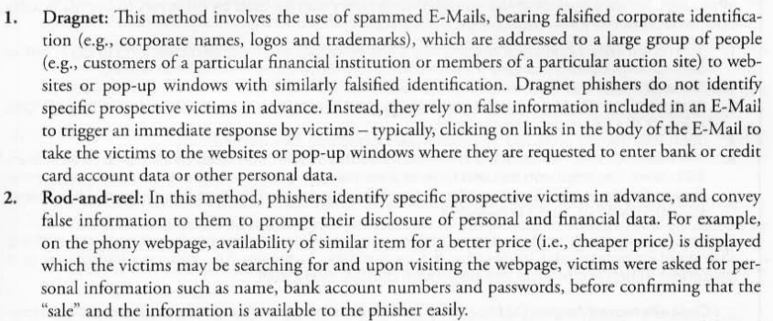

Slide 11
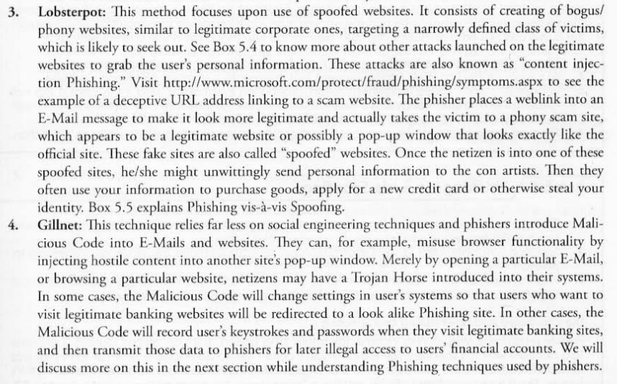

Slide 12
Phishing Techniques
URL (weblink) manipulation
Filter evasion
Website forgery
Flash Phishing
Social Phishing
Phone Phishing
Phishers usually send millions of E-Mail messages, pop-up windows, etc., that appear to be looking official and legitimate.

Slide 13
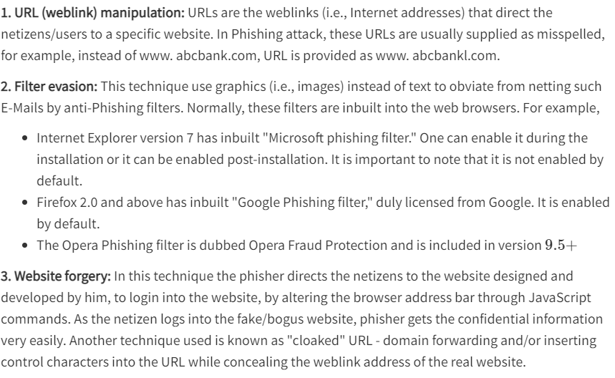
Phishing Techniques

Slide 14
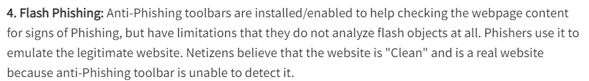
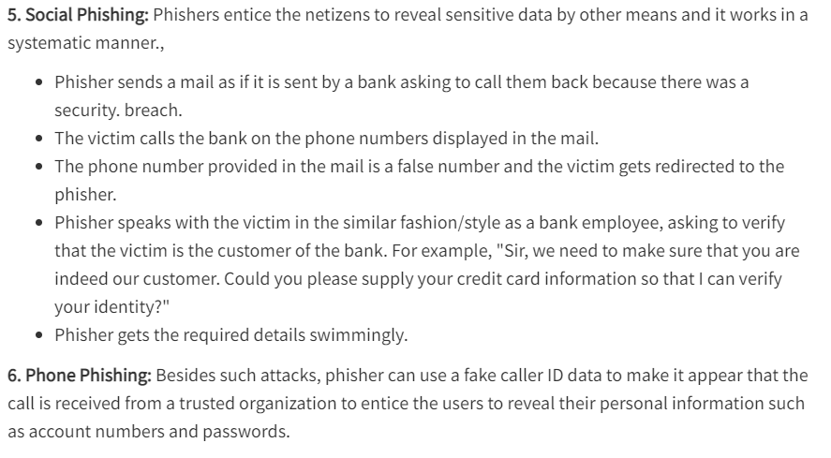
Phishing Techniques

Slide 15
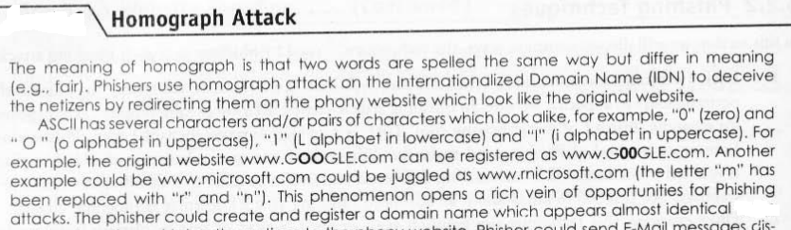
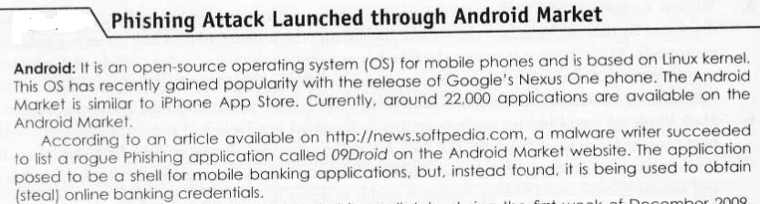
Phishing Techniques

Slide 16
Spear Phishing
A method of sending a Phishing message to a particular organization to gain organizational information for more targeted social engineering.
Spear phishers send E-Mail that appears genuine
The message might look like as if it has come from your employer, or from a colleague who might send an E-Mail message to everyone in the company (such as the person who manages the computer systems); it could include requests for usernames or passwords.

Slide 17
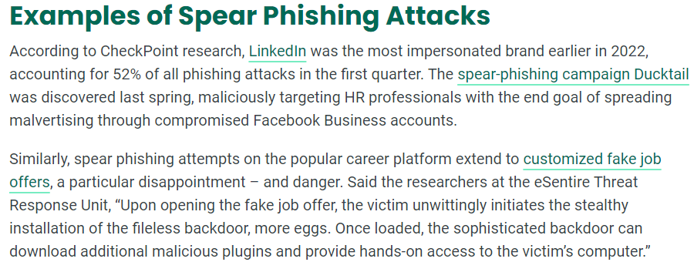

Slide 18
Whaling
A specific form of “Phishing” and/or “Spear Phishing” – targeting executives from the top management in the organizations, usually from private companies.
The objective is to swindle the executives into revealing confidential information.
Whaling targets C-level executives sometimes with the help of information gleaned through Spear Phishing, aimed at installing malware for keylogging or other backdoor access mechanisms.
E-Mails sent in the whaling scams are designed to masquerade as a critical business E-Mail sent from a legitimate business body and/or business authority.
Whaling phishers have also forged official looking FBI subpoena E-Mails and claimed that the manager needs to click a link and install special software to view the subpoena.
In a 2008 FBI subpoena whaling scam, 20,000 corporate CEOs of various private organizations were attacked. Approximately 2000 of them, fell for it and clicked on the whaling link, believing that a browser add on will be downloaded, to view the entire subpoena document. But in reality, it was a keylogger software, that secretly recorded the CEOs passwords, and forwarded it to the phishers.

Slide 19
Types of Phishing Scams
Deceptive Phishing
Malware-based Phishing
Keyloggers
Session hijacking
In-session Phishing
6. Web Trojans
7. Pharming
8. System reconfiguration attacks
9. Data theft
10. Content-injection Phishing
11. Man-in-the-middle Phishing
12. Search engine Phishing
13. SSL certificate Phishing

Slide 20
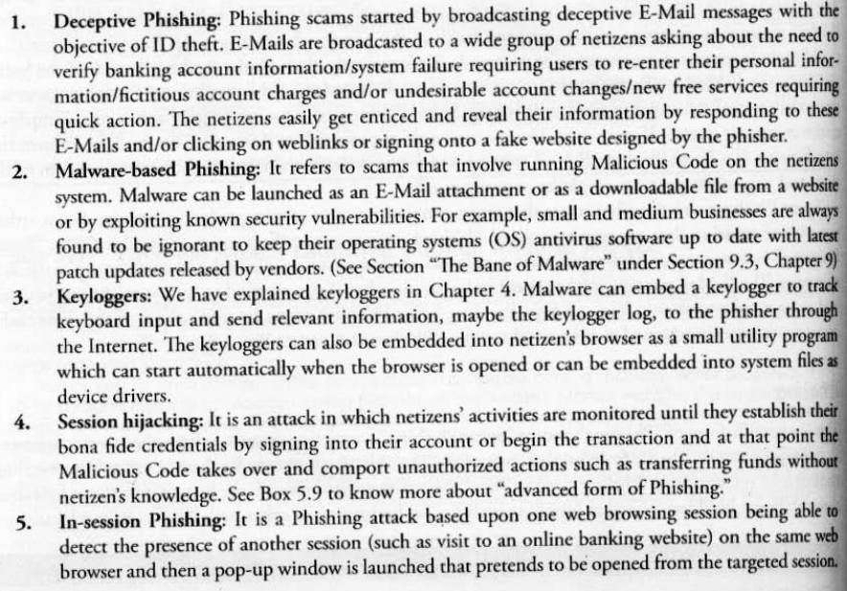
Types of Phishing Scams

Slide 21
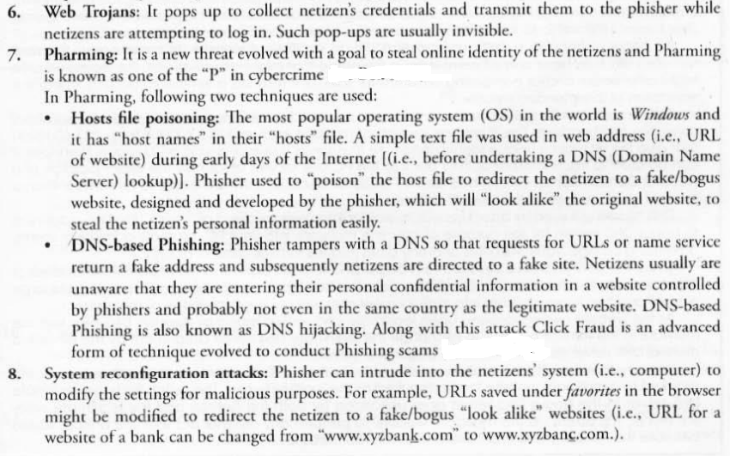
Types of Phishing Scams(Contd)
DNS servers translate domain names into IP addresses, making it possible for DNS clients to reach the origin server.

Slide 22
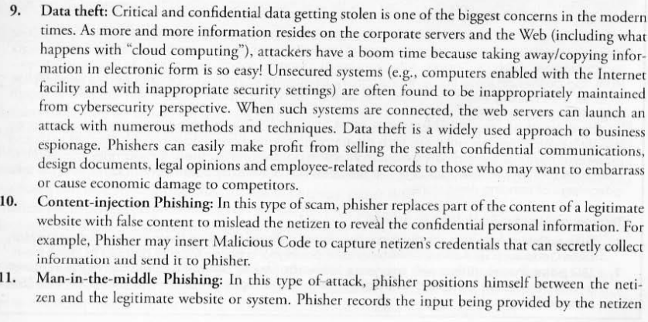
Types of Phishing Scams(Contd)

Slide 23
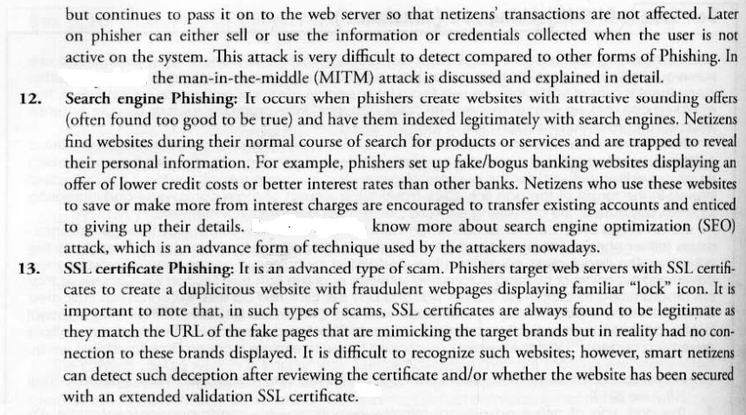
Types of Phishing Scams(Contd)

Slide 24

Types of Phishing Scams(Contd)
An SSL certificate is a digital certificate that authenticates a website's identity and enables an encrypted connection. SSL stands for Secure Sockets Layer, a security protocol that creates an encrypted link between a web server and a web browser.
Companies and organizations need to add SSL certificates to their websites to secure online transactions and keep customer information private and secure.
SSL works by ensuring that any data transferred between users and websites, or between two systems, remains impossible to read. It uses encryption algorithms to scramble data in transit, which prevents hackers from reading it as it is sent over the connection. This data includes potentially sensitive information such as names, addresses, credit card numbers, or other financial details.
When you see a padlock icon next to the URL in the address bar, that means SSL protects the website you are visiting.
Example website:

Slide 25
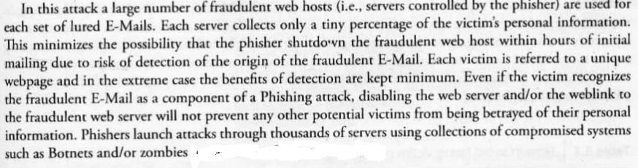
Distributed Phishing Attack (DPA)
An advanced form of phishing attack that works as per victim’s personalization of the location of sites collecting credentials and a covert transmission of credentials to a hidden coordination center run by the phisher.
A large number of fraudulent web hosts are used for each set of lured E-Mails.
Each server collects only a tiny percentage of the victim’s personal information.

Slide 26
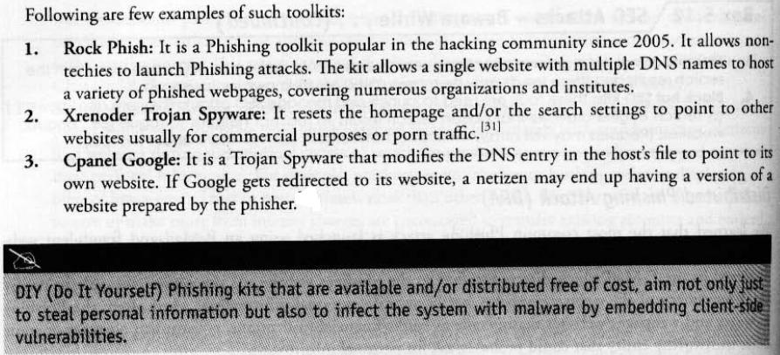
Phishing Toolkits and Spy Phishing
A Phishing toolkit is a set of scripts/programs
Quite expensive
Phishers use hypertext preprocessor (PHP) to develop the Phishing kits.
Most of the Phishing kits are advertised and distributed at no charge and usually these free Phishing kits – also called DIY (Do It Yourself ) Phishing kits.

Slide 27
Phishing Countermeasures
The countermeasures prevent malicious attacks that phisher may target to gain the unauthorized access to the system to steal the relevant personal information about the victim, from the system.
It is always challenging to recognize/judge the legitimacy of a website while Googling.
SPS Algorithm to Thwart Phishing Attacks
With Sanitizing Proxy System (SPS), web Phishing attack can be immunized by removing part of the content that entices the netizens into entering their personal information.
SPS sanitizes all HTTP responses from suspicious URLs with warning messages.
Security Measures to avoid being victims of Phishing attacks
Keep antivirus up to date
Do not click on hyperlinks in E mails
Take advantage of antispam software
Verify HTTPS
Firewall
Do not enter sensitive or financial information into Pop up windows
Secure the host files
Use backup System images

Slide 28
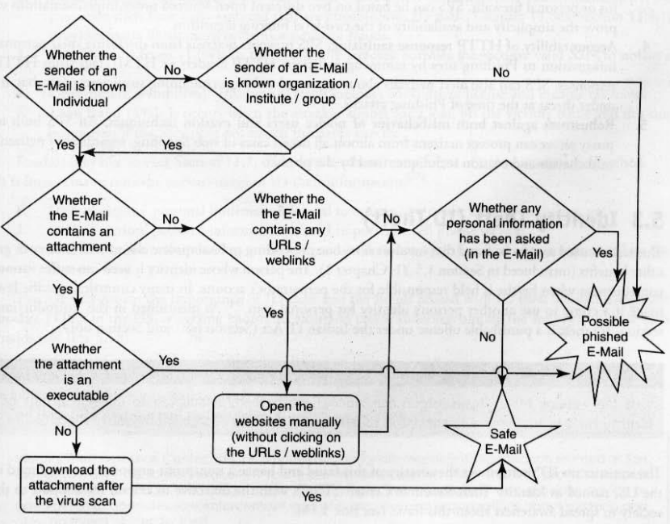
Flowchart distinguishing between legitimate E-mail and Phished E- mail

Slide 29
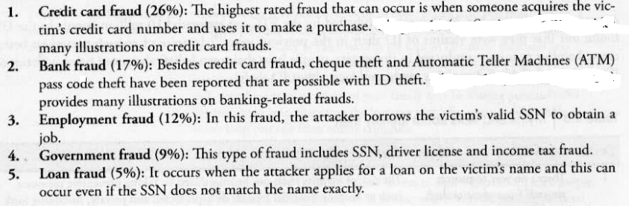
Identity Theft (ID Theft)
Fraud that involves someone pretending to be someone else to steal money or get other benefits.
The person whose identity is used can suffer various consequences when he/she is held responsible for the perpetrator’s actions.
Statistics as per Federal Trade Commission (FTC)
1. Credit card fraud (26%)
2. Bank fraud (17%)
3. Employment fraud (12%)
4. Government fraud (9%)
5. Loan fraud (5%)

Slide 30
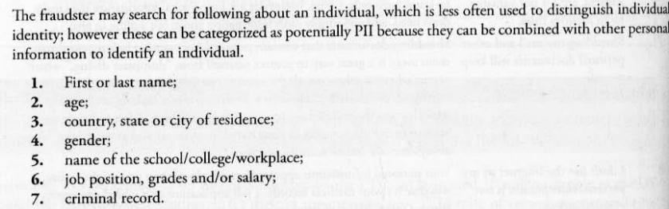
Personally Identifiable Information (PII)
Fraudsters attempts to steal the elements mentioned below:
1. Full name
2. National identification number (e.g., SSN)
3. Telephone and mobile phone numbers
4. Driver’s license number
5. Credit card numbers
6. Digital identity (e.g., E-Mail address, online account ID and password)
7. Birth date and Place name
9. Face and fingerprints

Slide 31
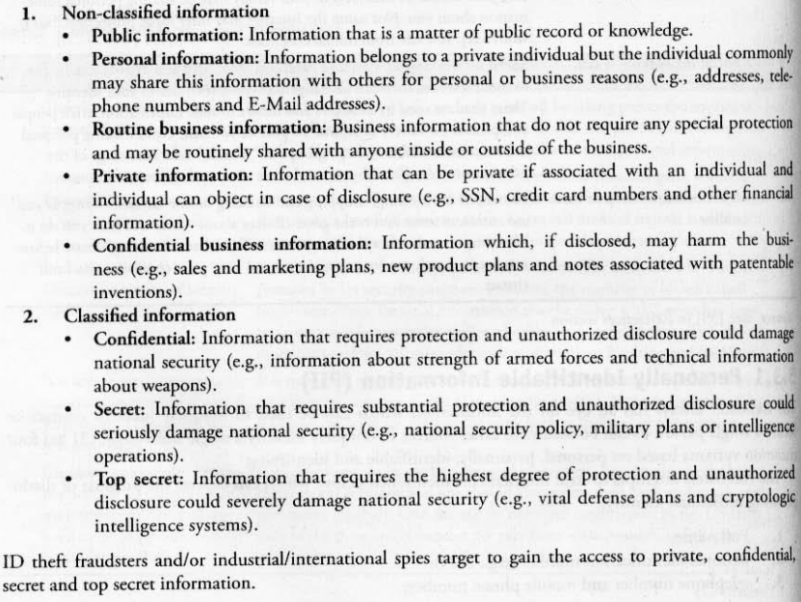
Personally Identifiable Information (PII) (contd)

Slide 32
A fraudster generally searches the following about an individual:
1. First or last name
2. age
3. country, state or city of residence
4. gender
5. name of the school/college/workplace
6. job position, grades and/or salary
7. criminal record
Types of Identity Theft
1. Financial identity theft
2. criminal identity theft
3. identity cloning
4. business identity theft
5. medical identity theft
6. synthetic identity theft
7. child identity theft
Techniques of ID Theft
1. Human-based methods
2. Computer-based technique

Slide 33
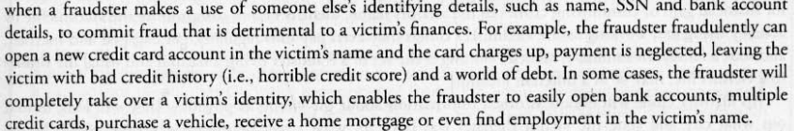
Types of Identity Theft

Slide 34
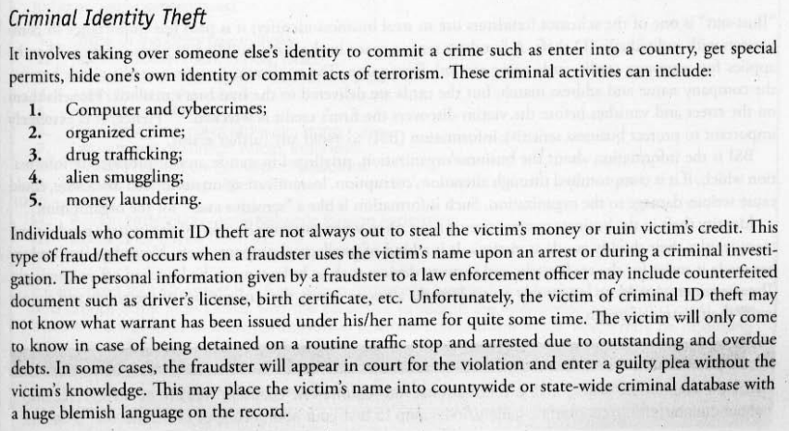
Types of Identity Theft

Slide 35
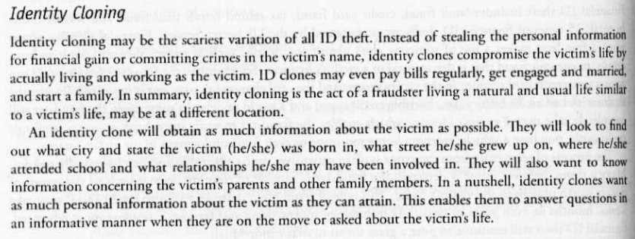
Types of Identity Theft

Slide 36
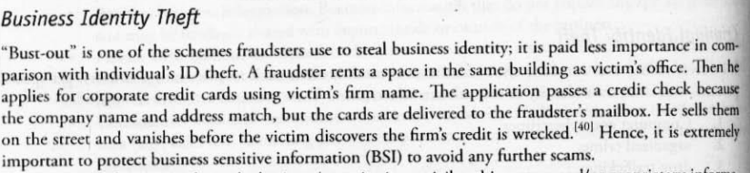
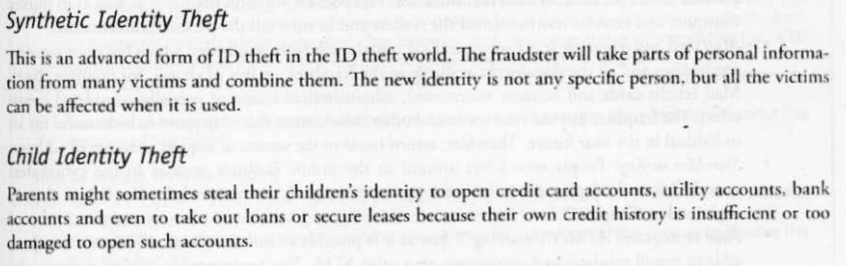
Types of Identity Theft

Slide 37
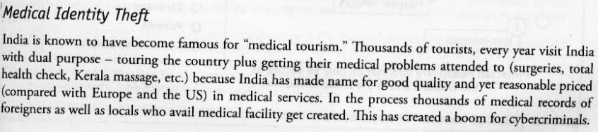
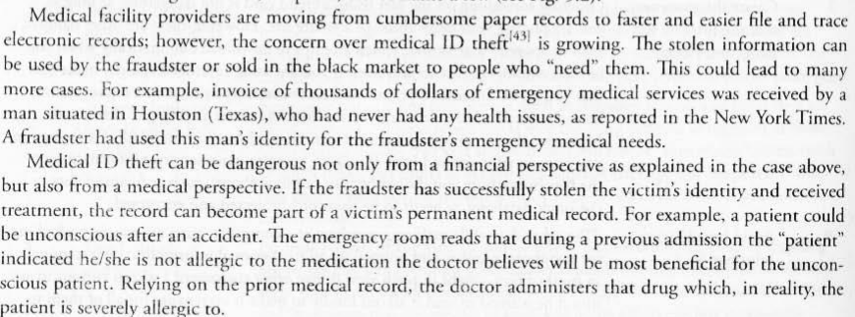
Types of Identity Theft

Slide 38
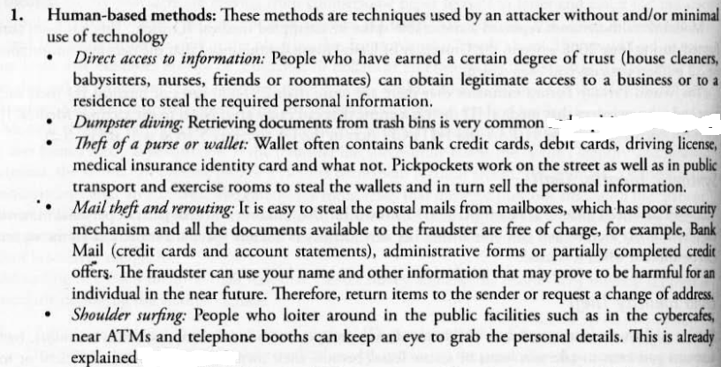
Techniques of ID Theft
1. Human-based methods
2. Computer-based technique

Slide 39
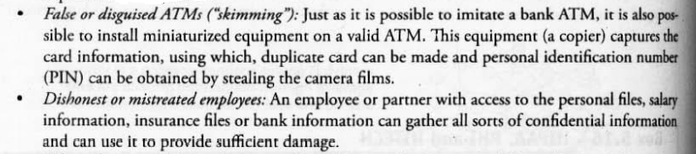
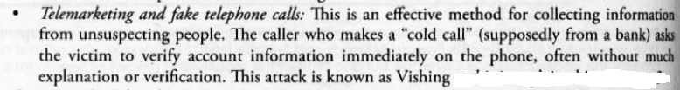
Techniques of ID Theft
Human-based methods (continued)

Slide 40
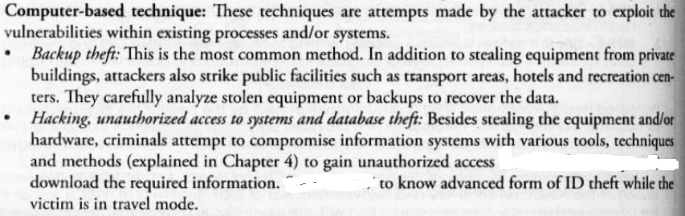
Techniques of ID Theft
Computer-based methods (continued)
Phishing
Pharming

Slide 41
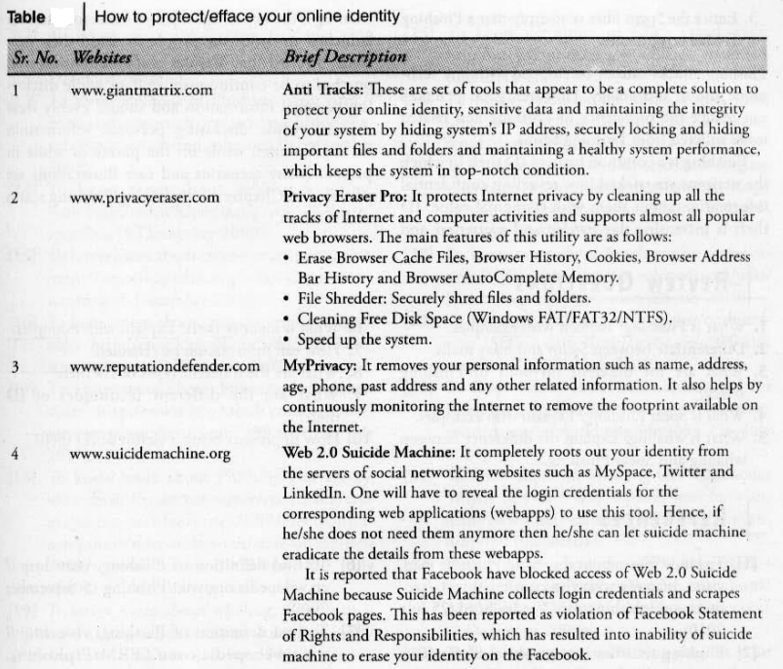

Slide 42
Questions
What is identity theft? Explain with examples.
Differentiate between hoax mails and spam.
Describe the different types of phishing scams
What are the different phishing techniques? Explain
What is spear phishing? Explain with examples.
What is whaling?
What are the different types of Identity thefts?
Describe Personally Identifiable Information (PII)

